Slide 1

NEEDATICKET
CONCERT TICKETS
Notes:
To change the image on this slide, select the picture and delete it. Then click the Pictures icon in the placeholder to insert your own image.

Slide 2
Arbeitsteilung
Berisa – Java Creator | Java Seller | Database | Webservices
Blaschke – Database | Webservices
Judth – Java Creator | Java Seller
Winkler – Android Customer | Android Staff | GIT Management

Slide 3
Requirements
Android Apps
[Customer] - Winkler
Show Ticket with QR Code that grants physical access to location
------------------------------------
[Staff] - Winkler
Login
Read QR Code of Ticket
Check Ticket and show Status
Redeem Ticket and make it used so it can‘t be used twice
Java Apps
[Creator] - Berisa
Create Artist
Create Concert
Calculate Security Factor
Approximate Wage for Staff
------------------------------------
[Seller] - Judth
Changes according to new data model
Webservice - Blaschke
Full rework
GraphQL
Apollo GraphQL
Firebase access (Mongo)
Deployment on Glitch (Now Heroku)
Database - Blaschke
Firebase (Now Mongo)

Slide 4
Customer App

Slide 5
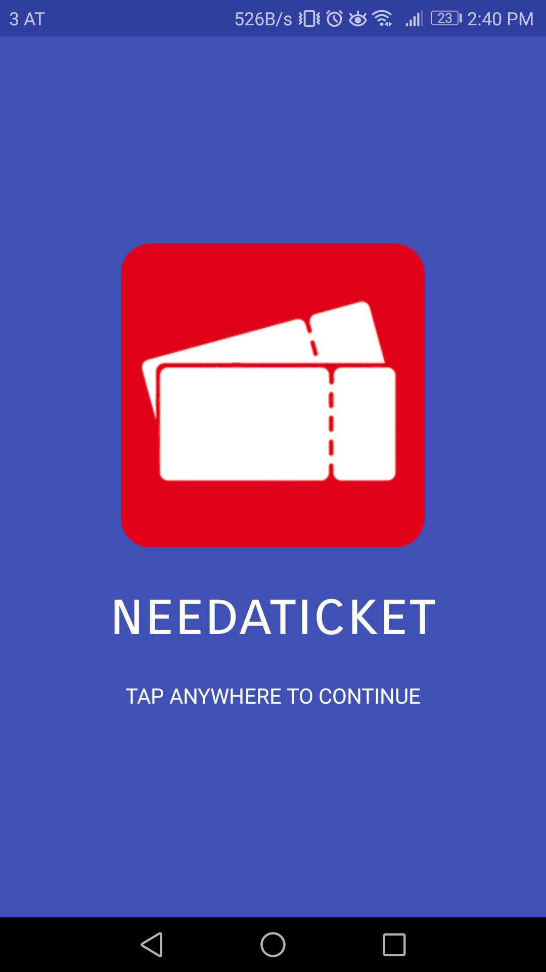
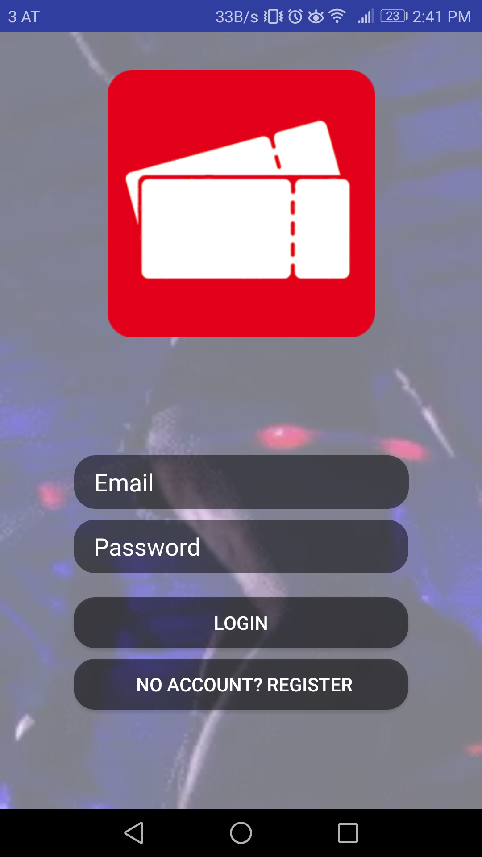
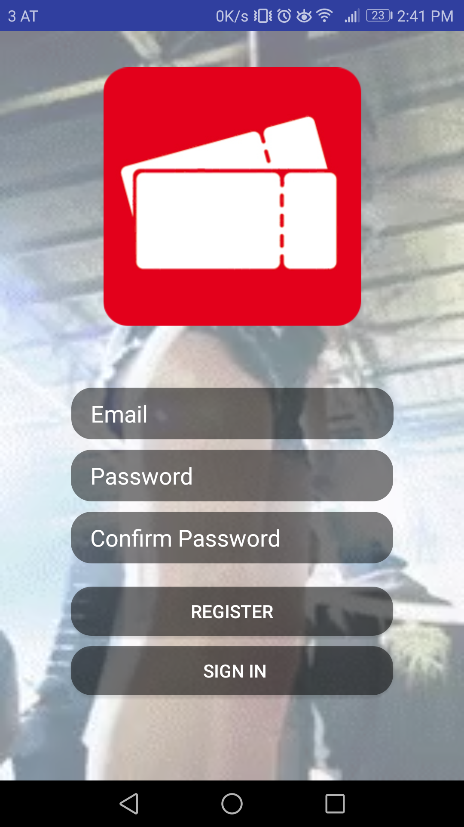
Android Apps
Welcome Screen
Login
Register

Slide 6
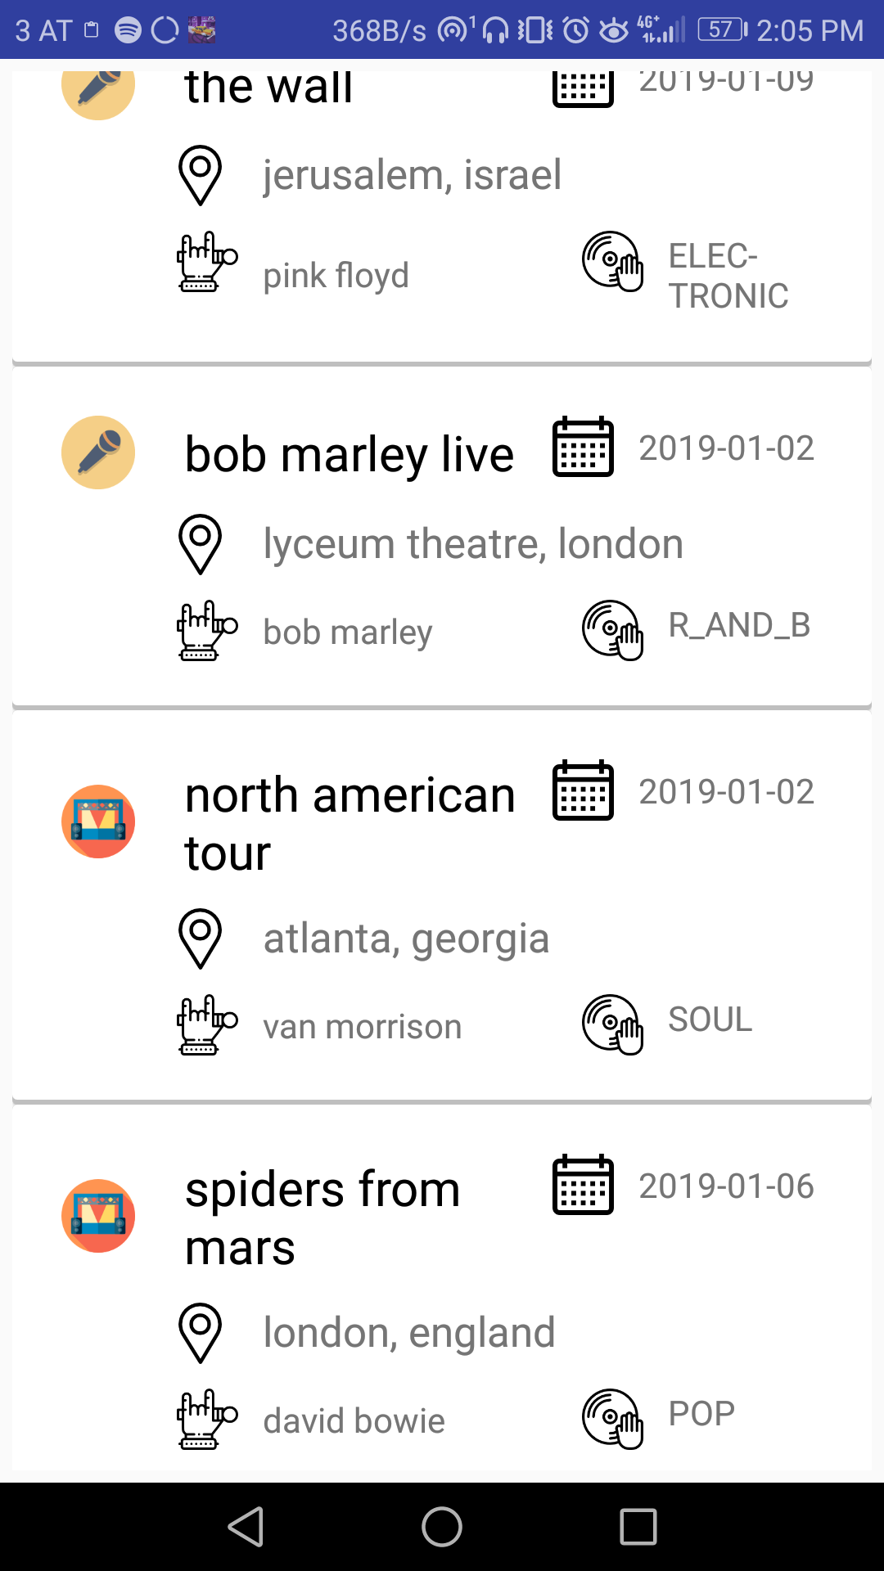
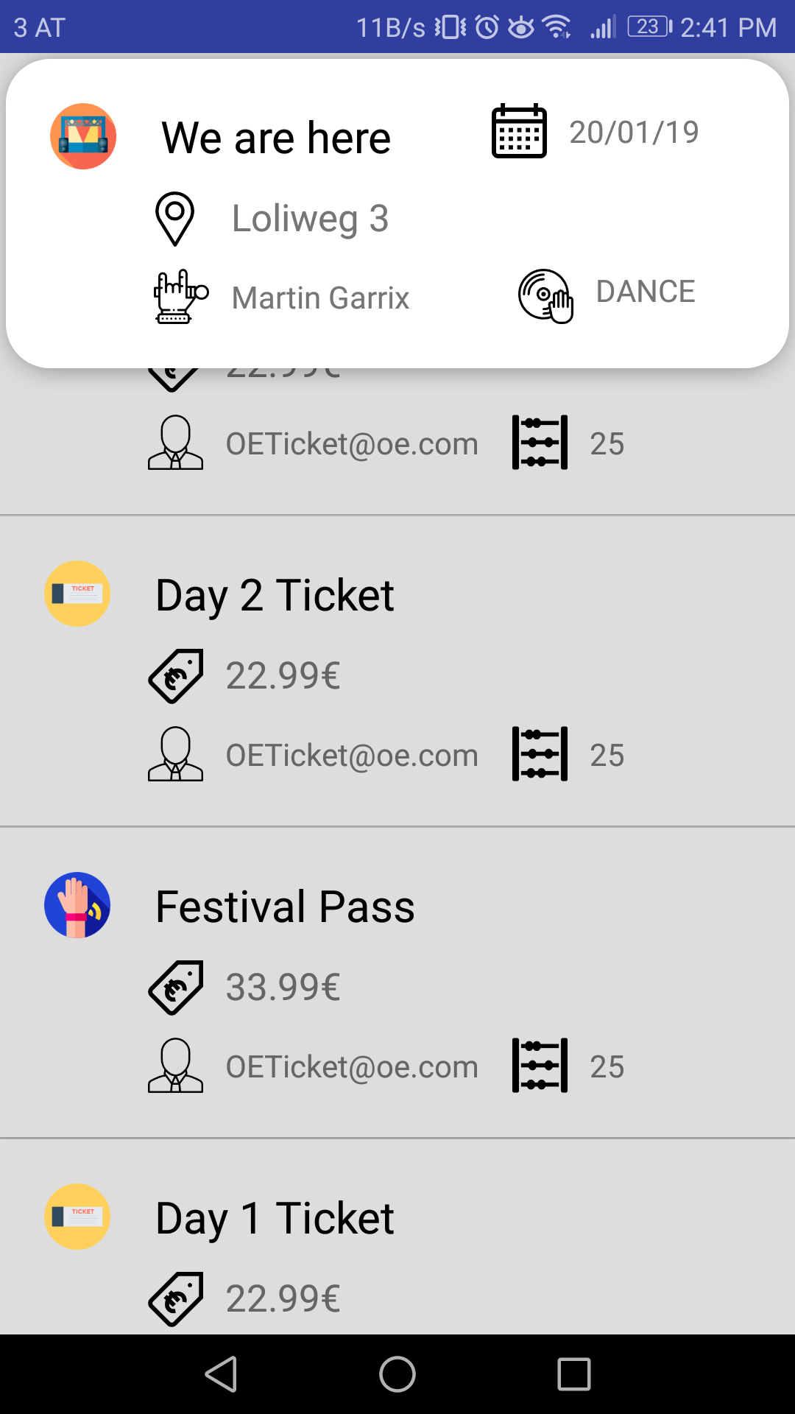
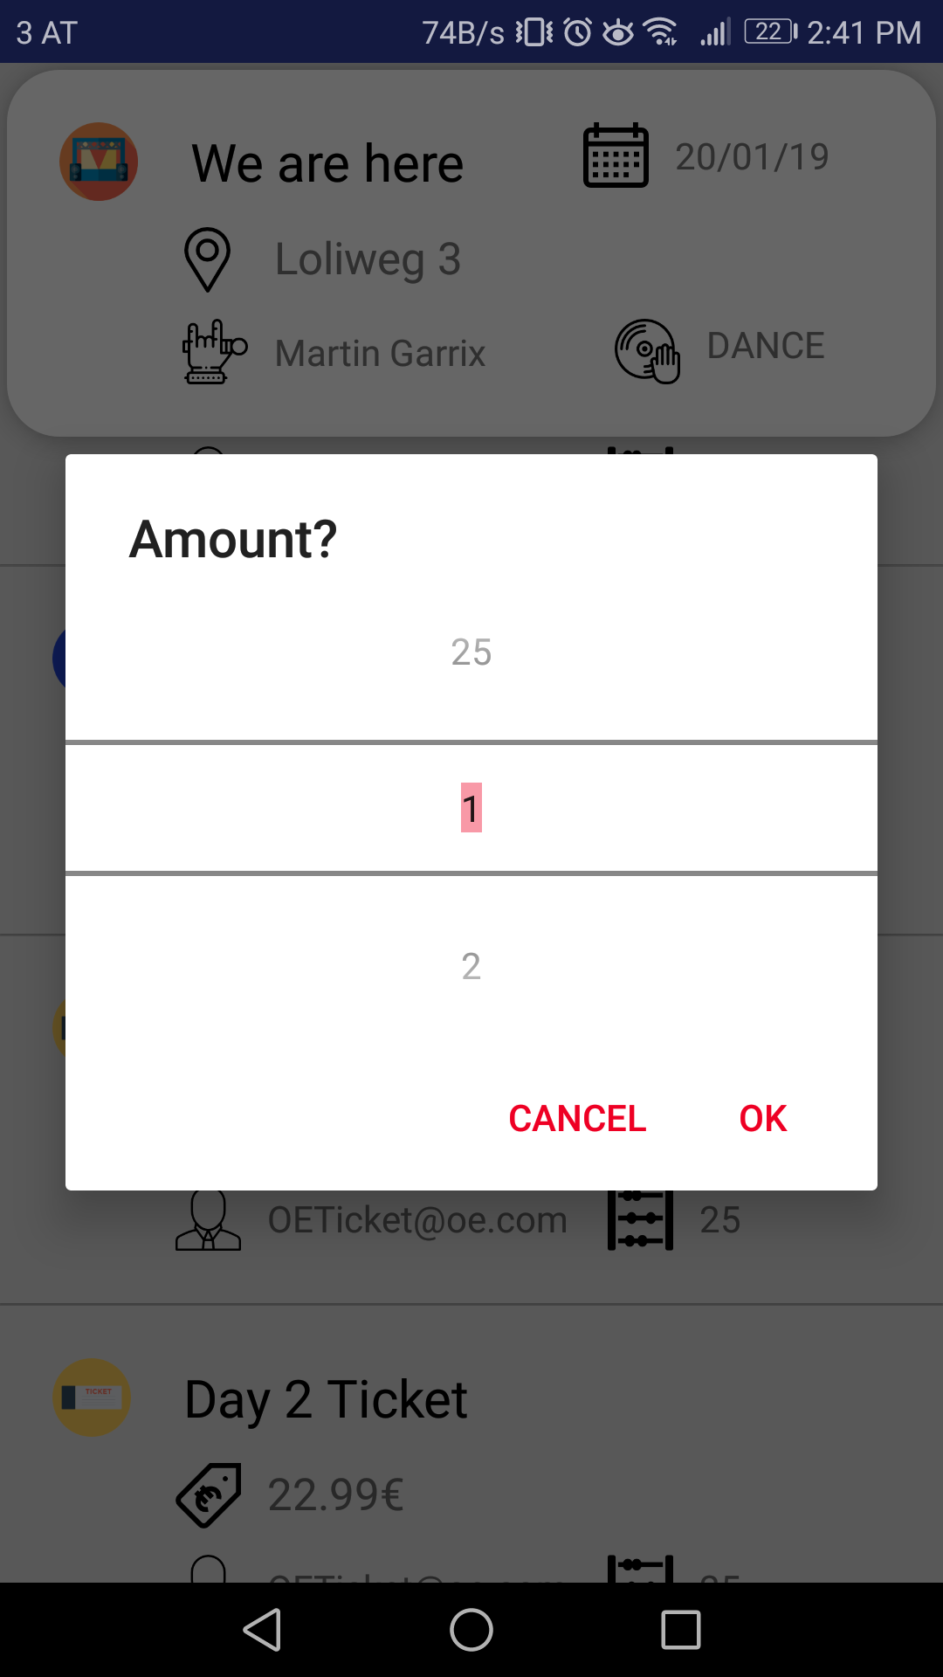
Android Apps
Concert list
Ticket list
Amount Picker

Slide 7
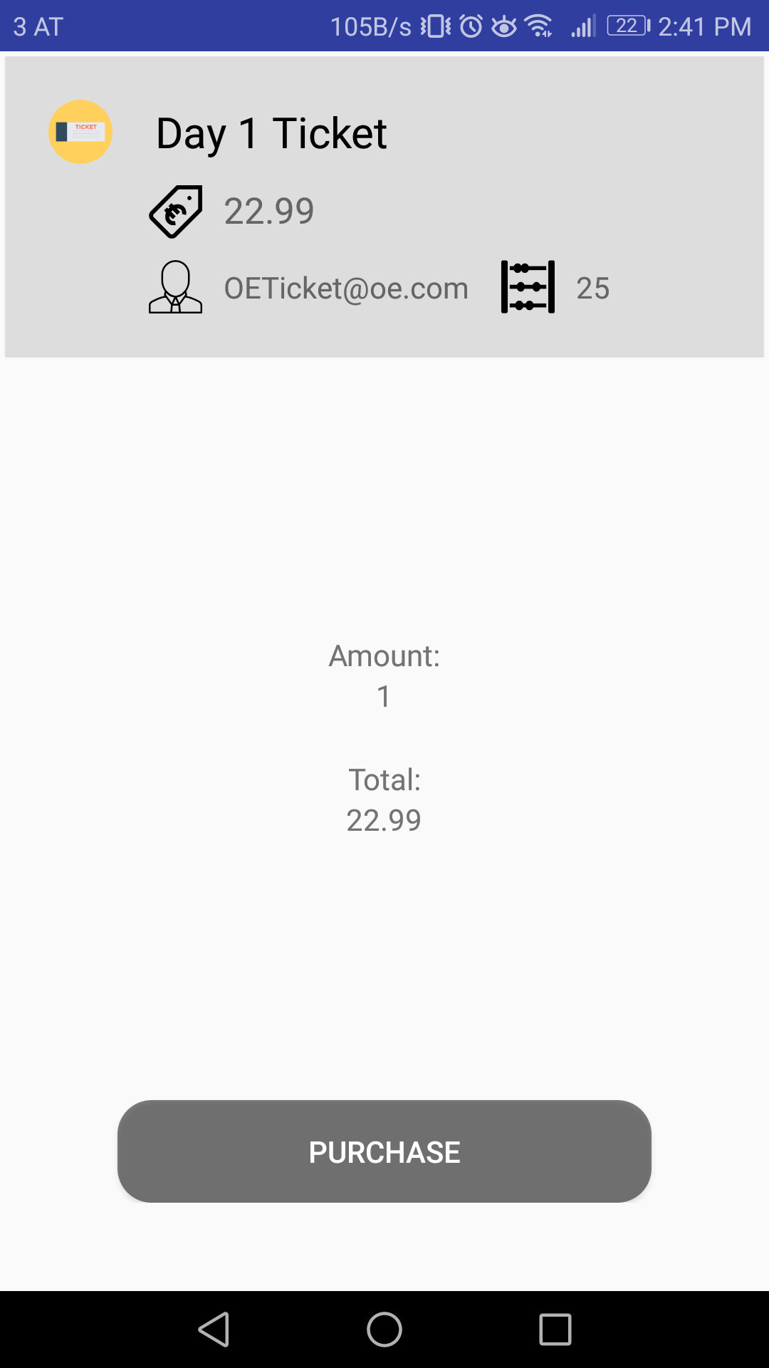
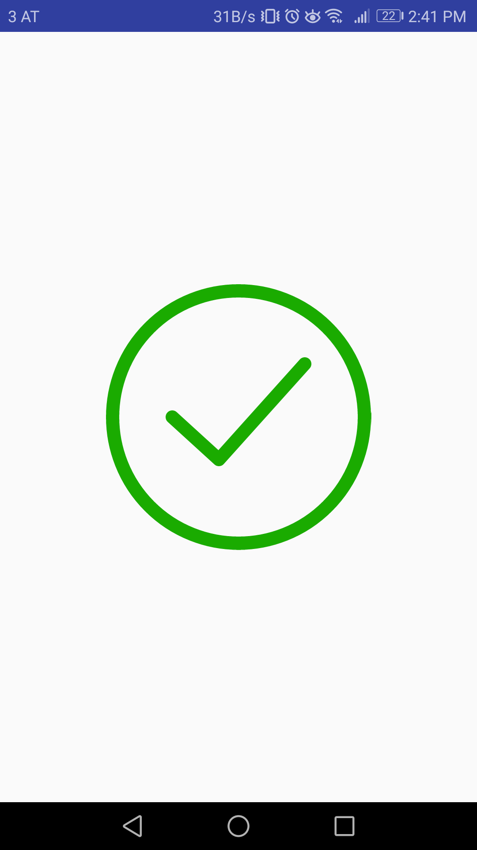
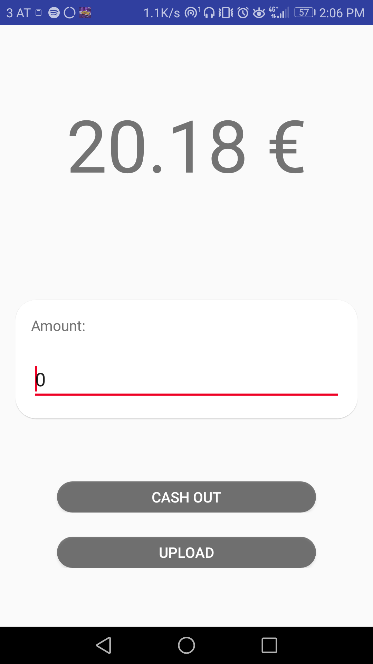
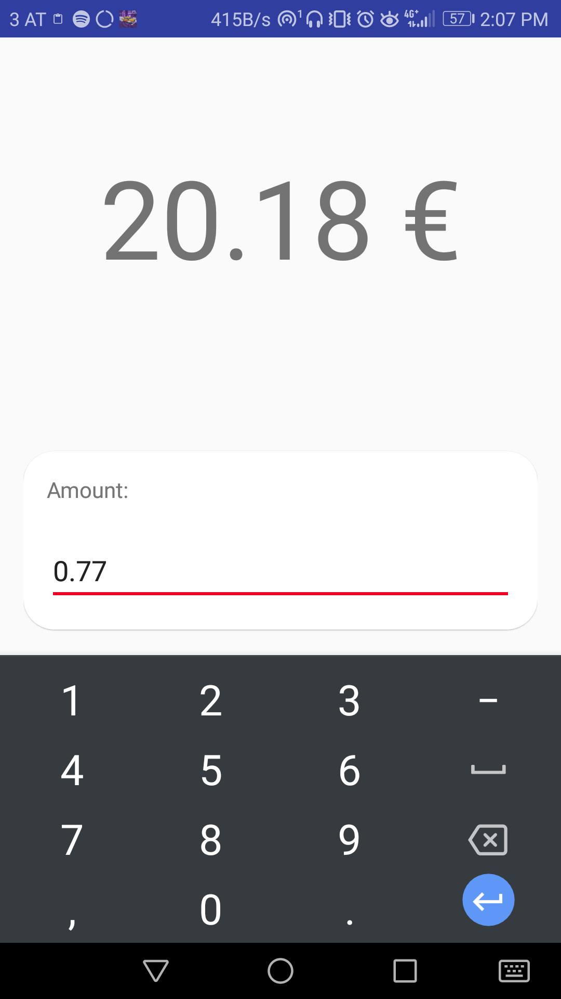
Android Apps
Buy ticket(s)
Checkmark (Anim)
Wallet (Anim)

Slide 8
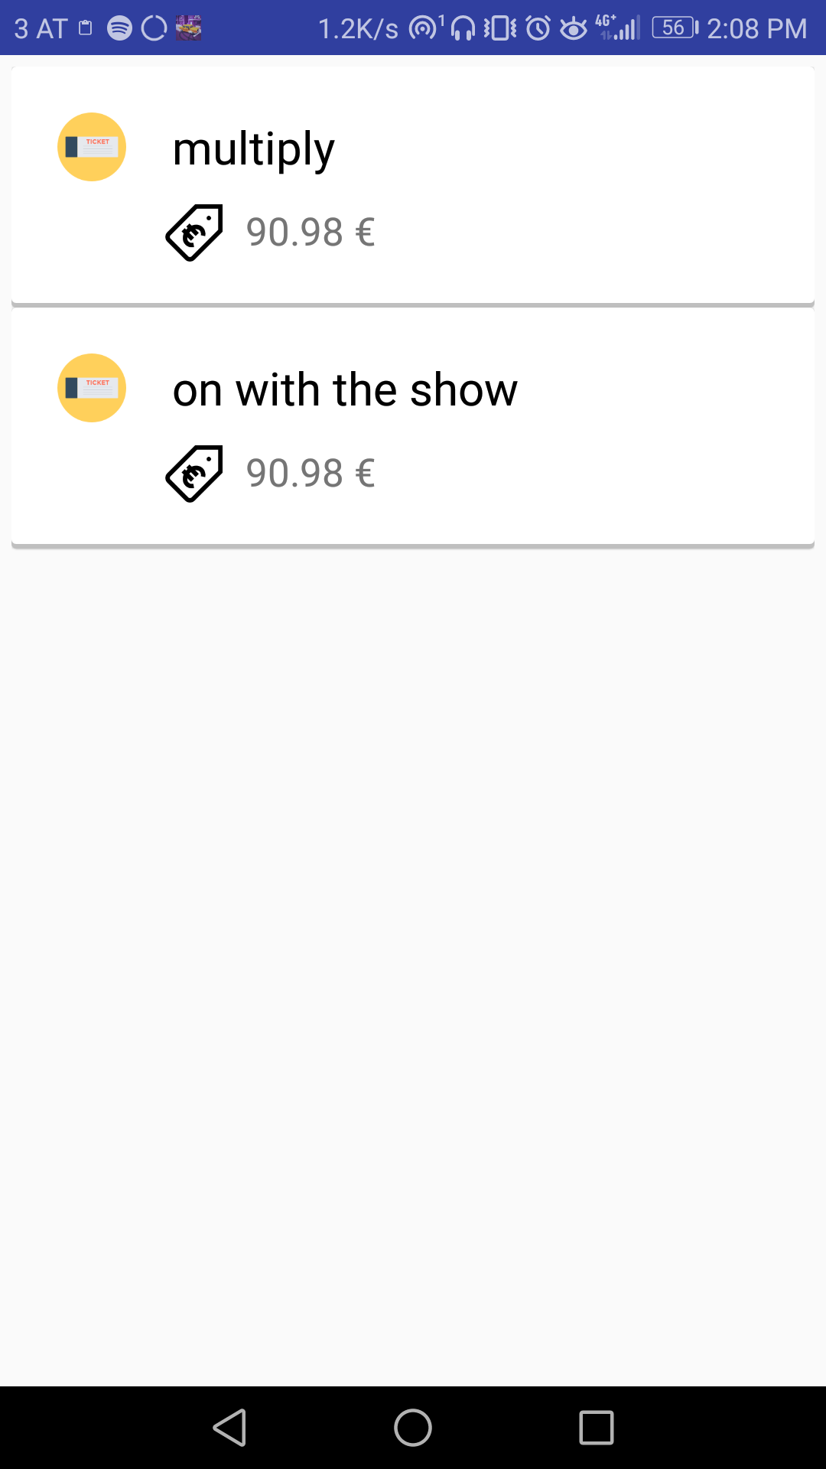
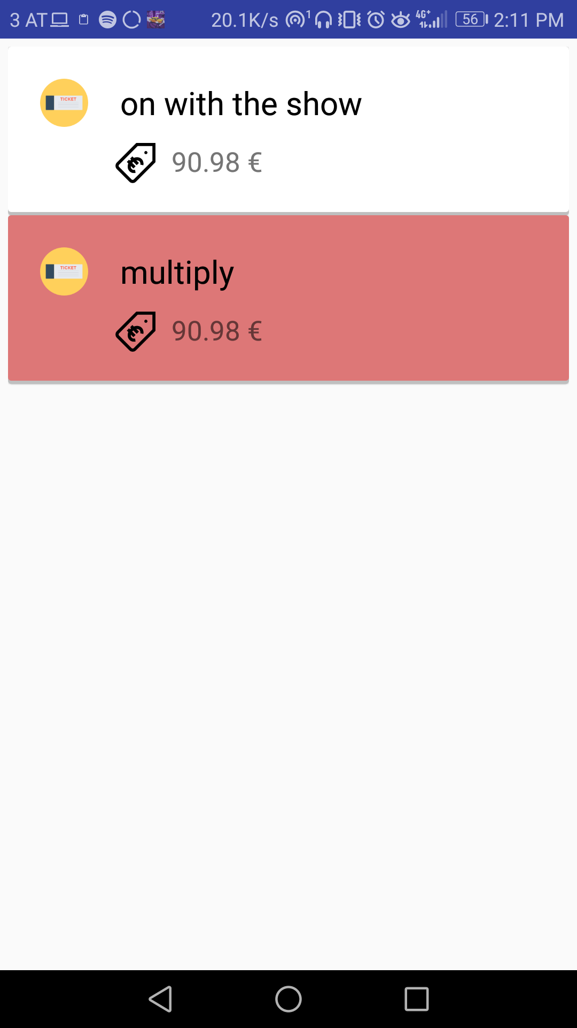
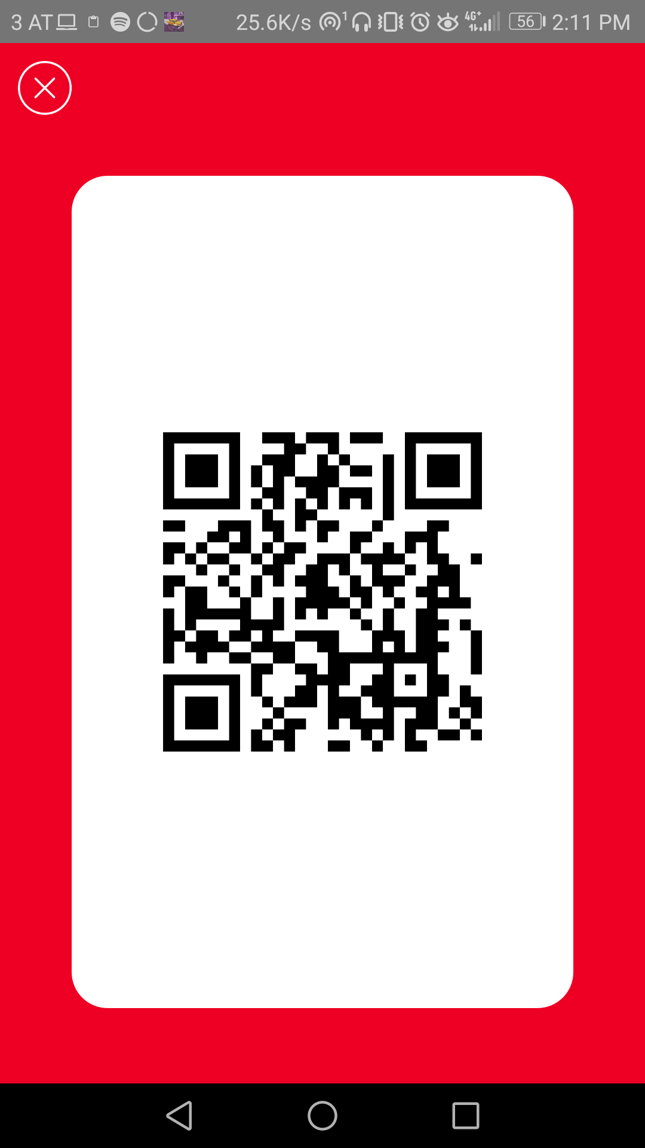
Android Apps
My Tickets
My Tickets after one got redeemed
QR Code

Slide 9
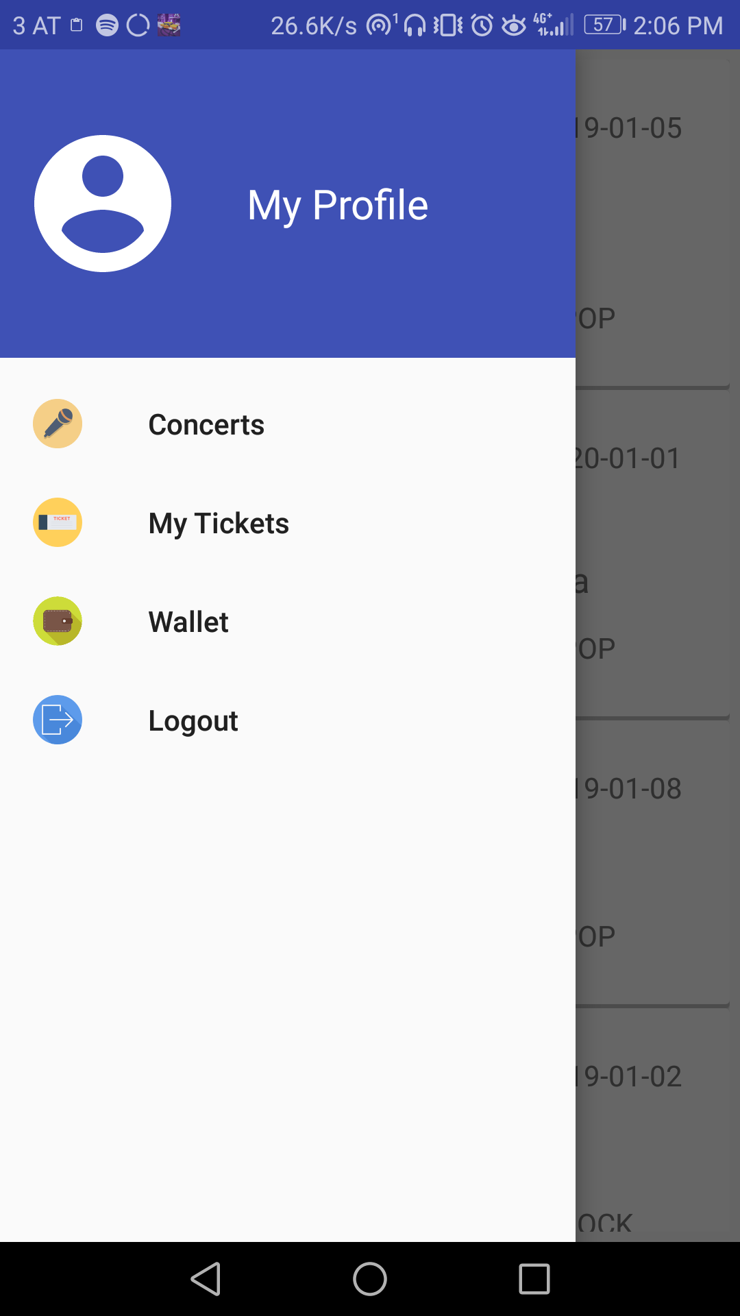
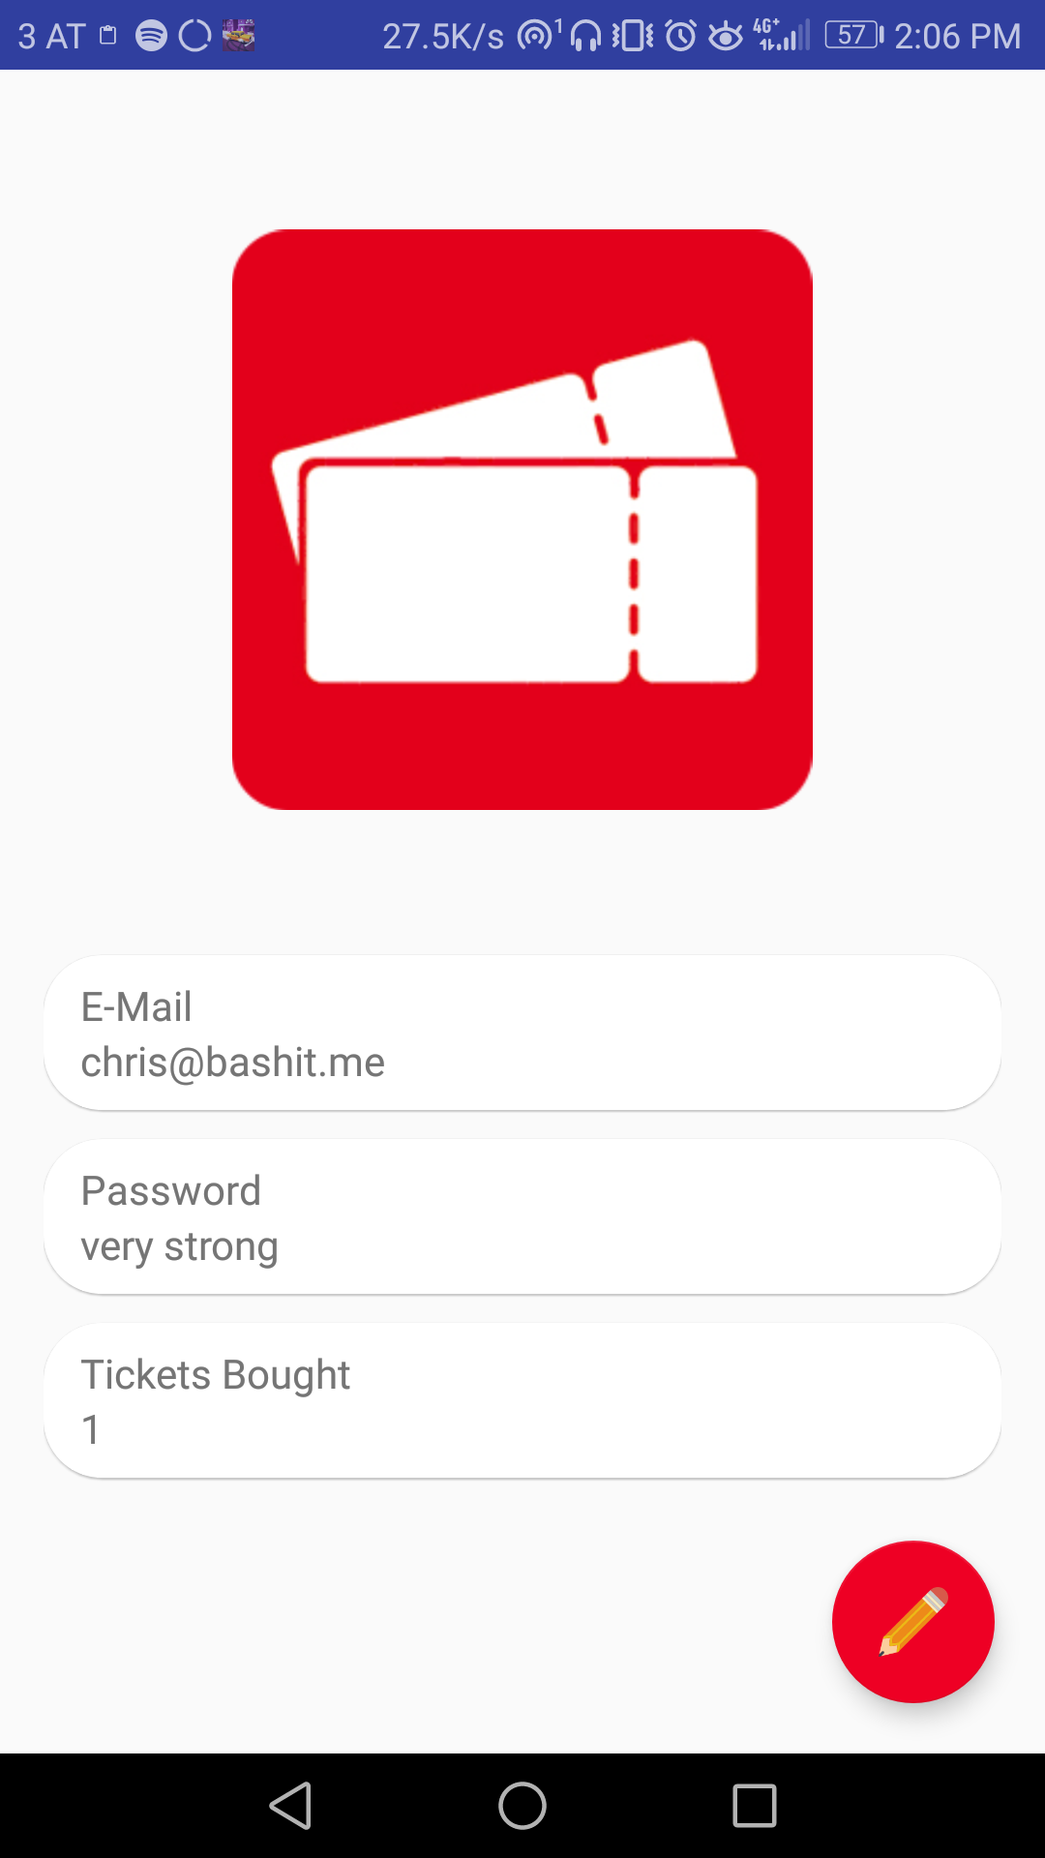
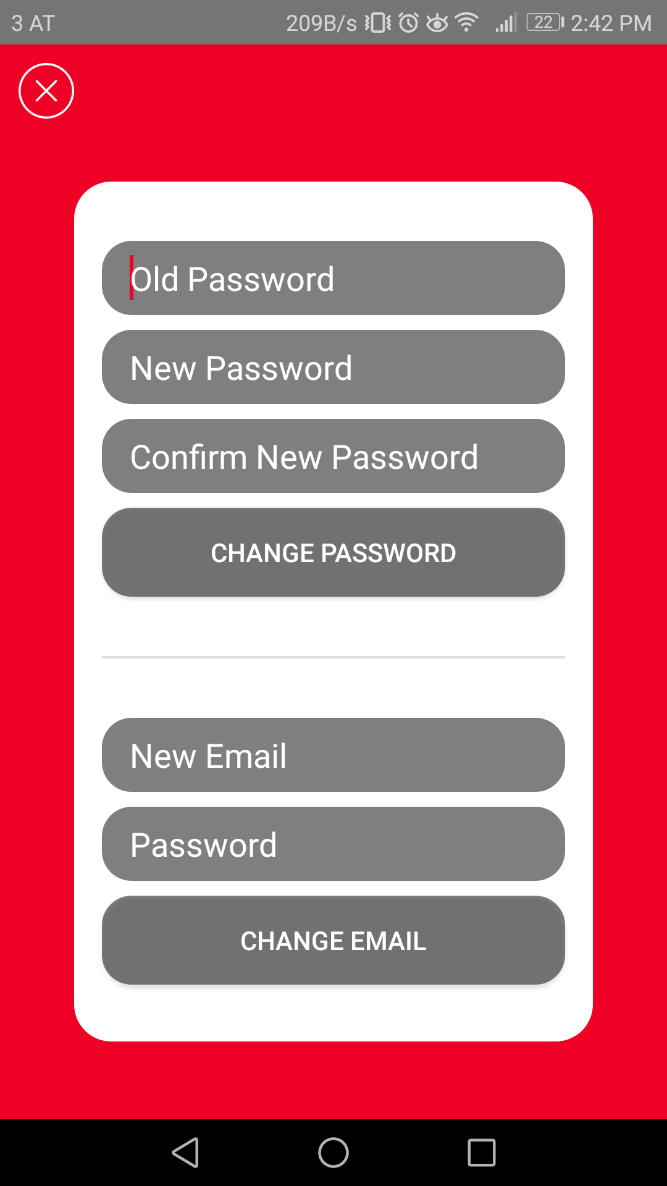
Android Apps
Navigation
User data
Change UD (Anim)

Slide 10
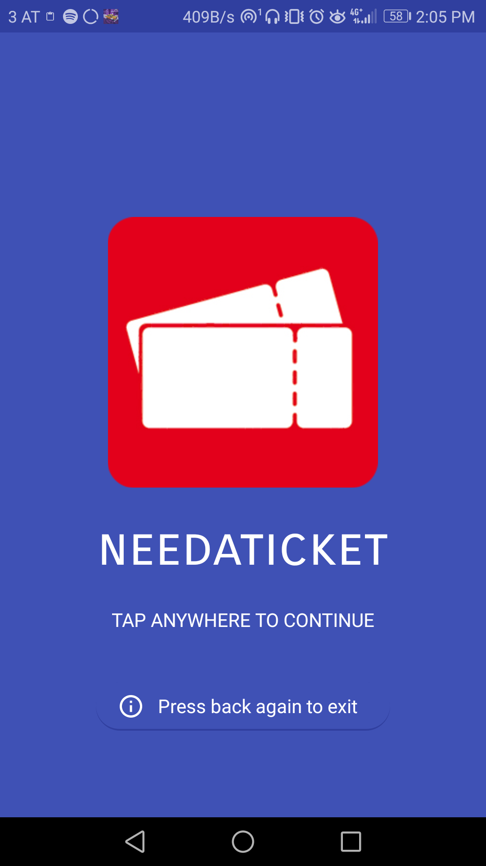
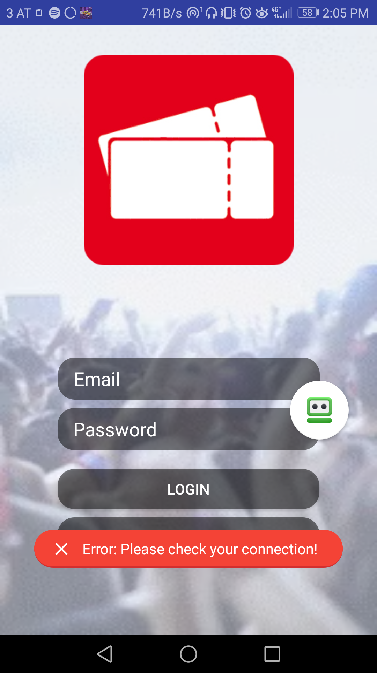
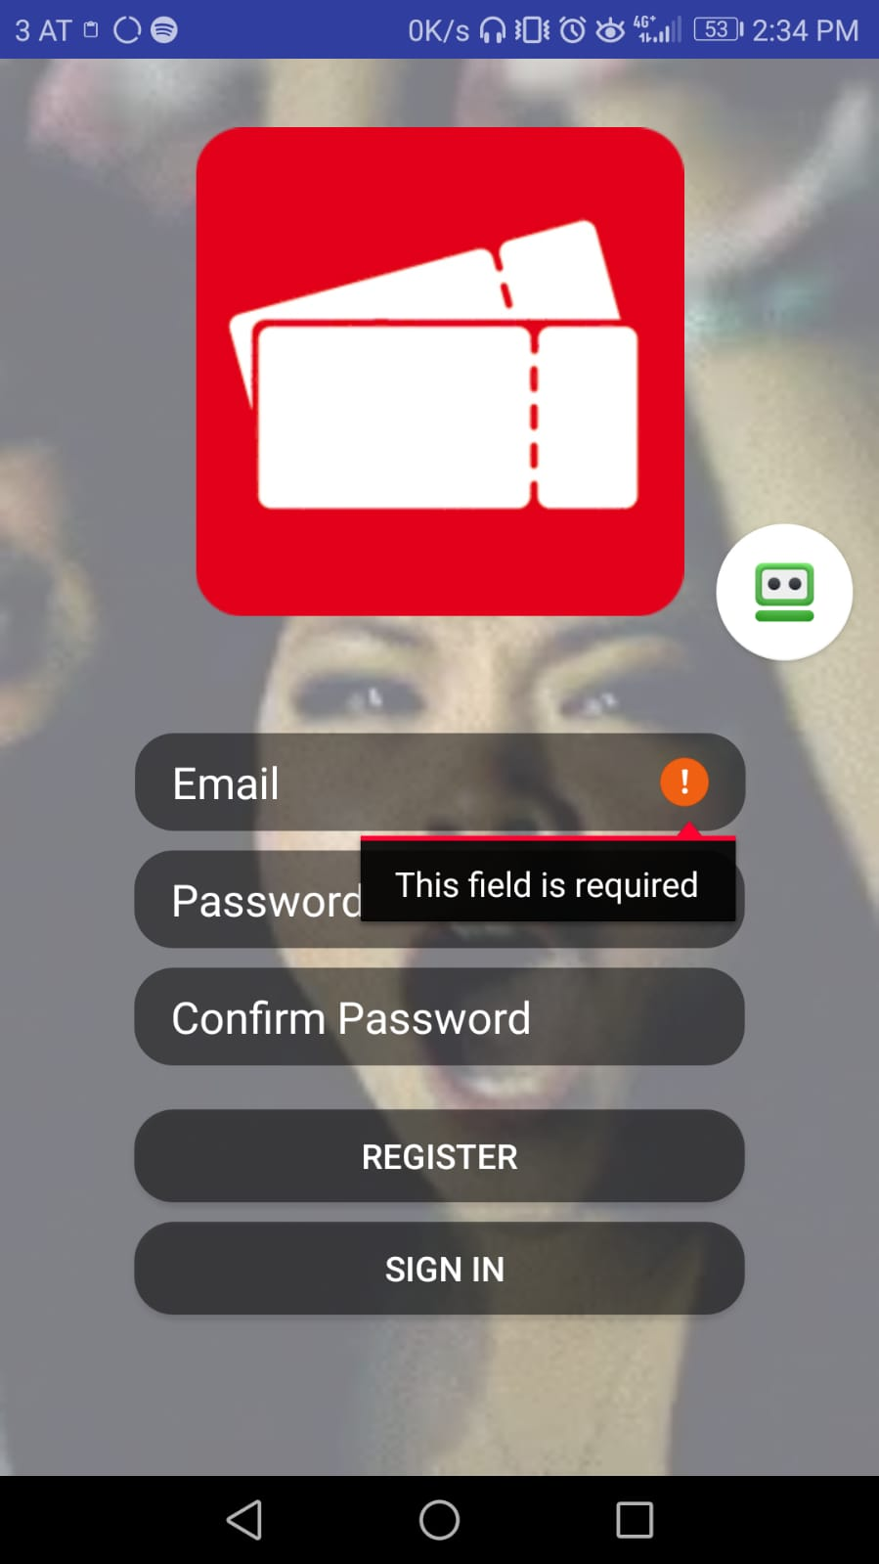
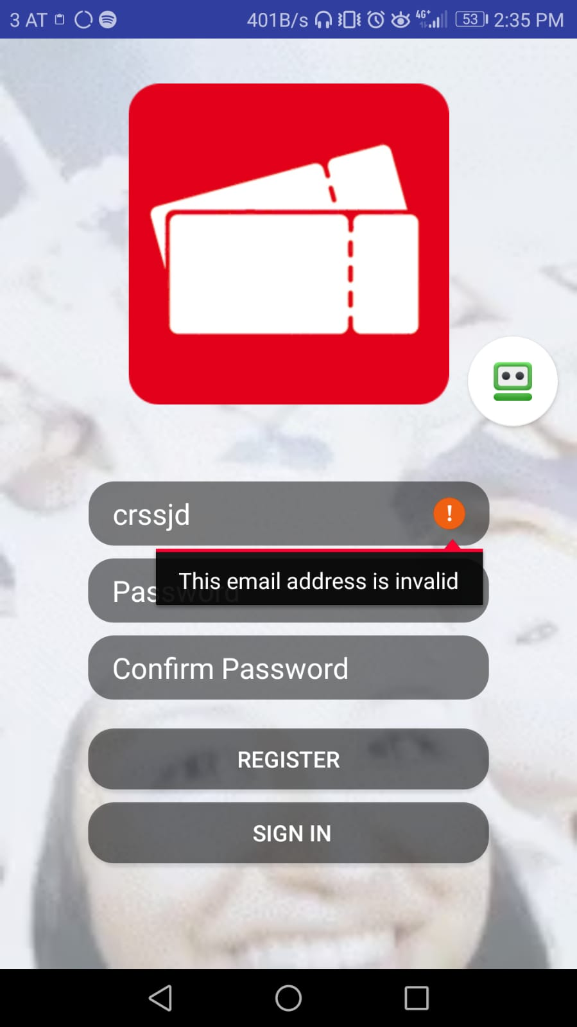
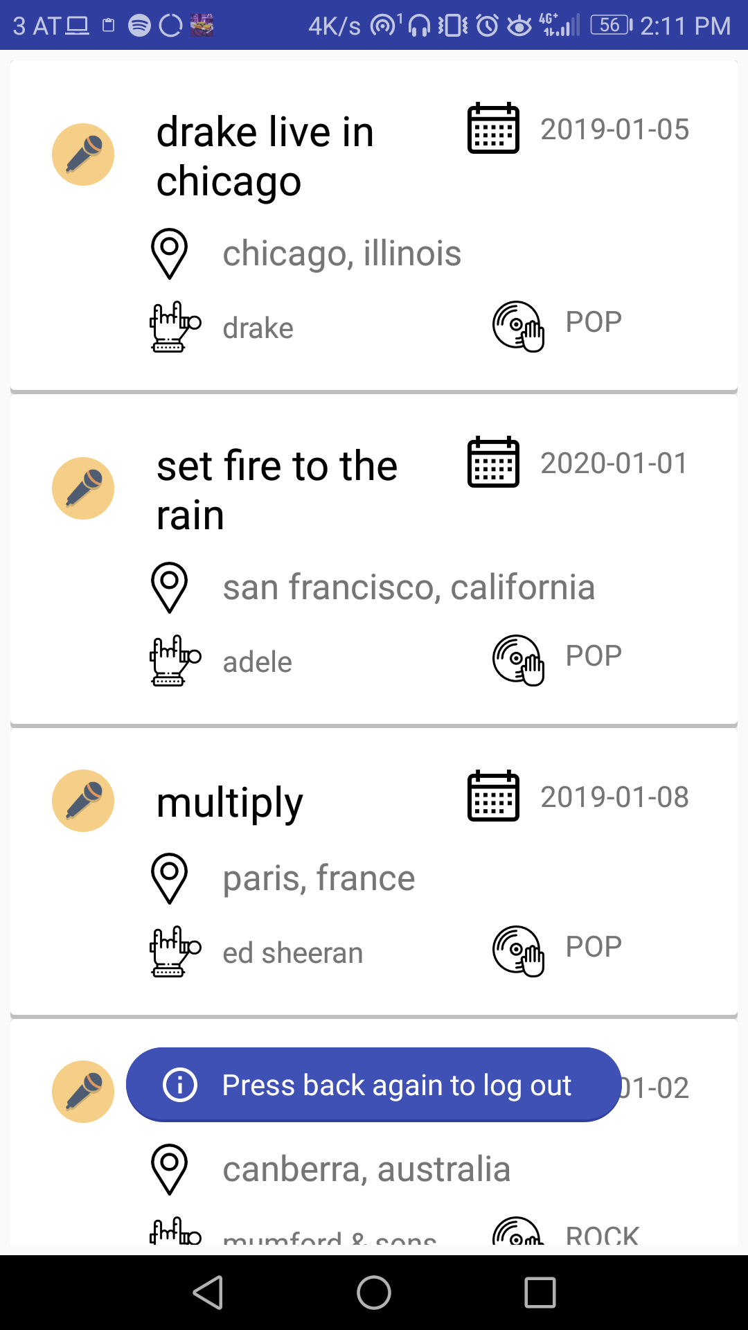
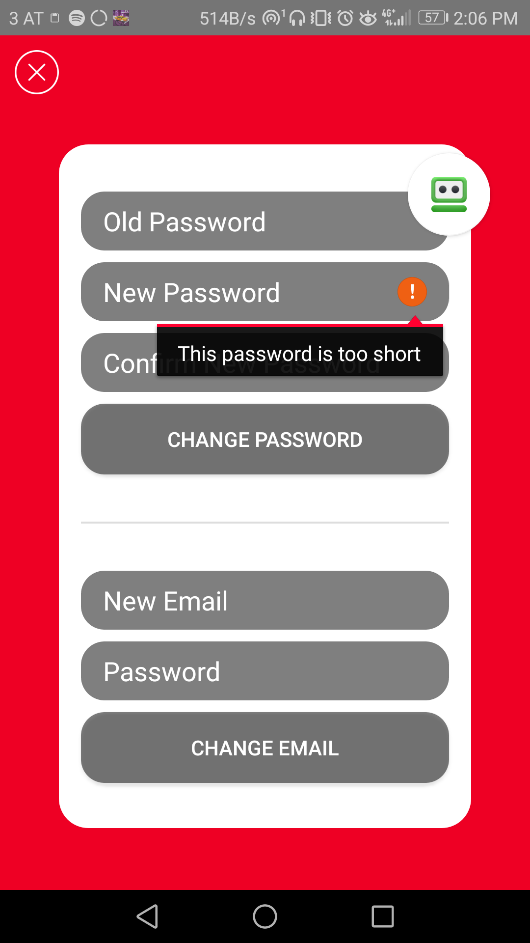
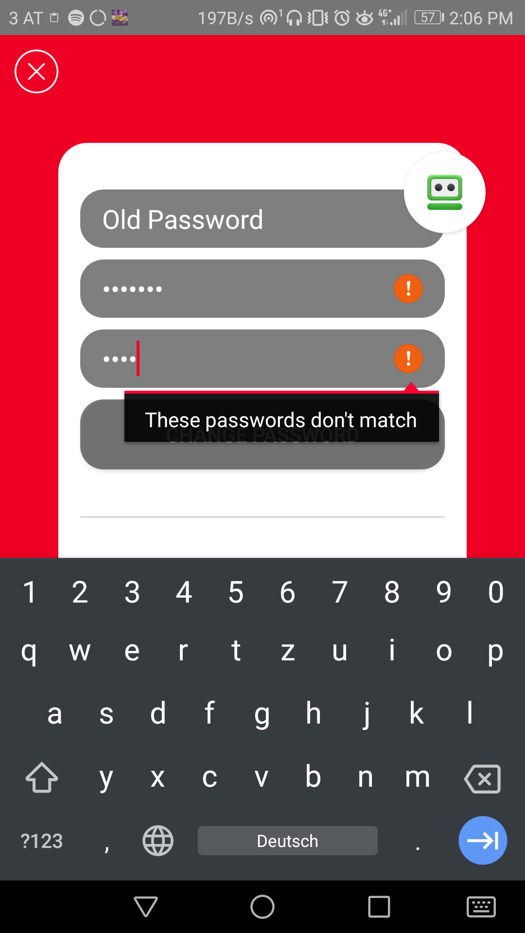
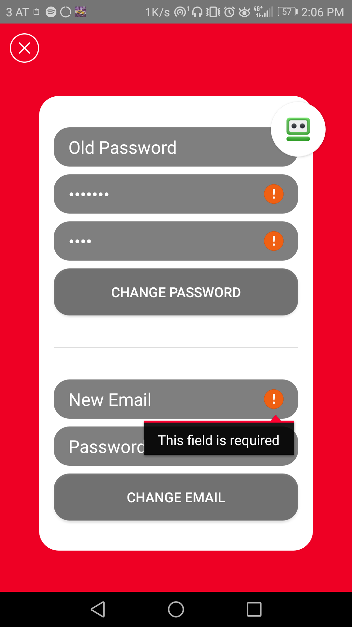
Android Apps
Error/Back handling

Slide 11
Staff App

Slide 12

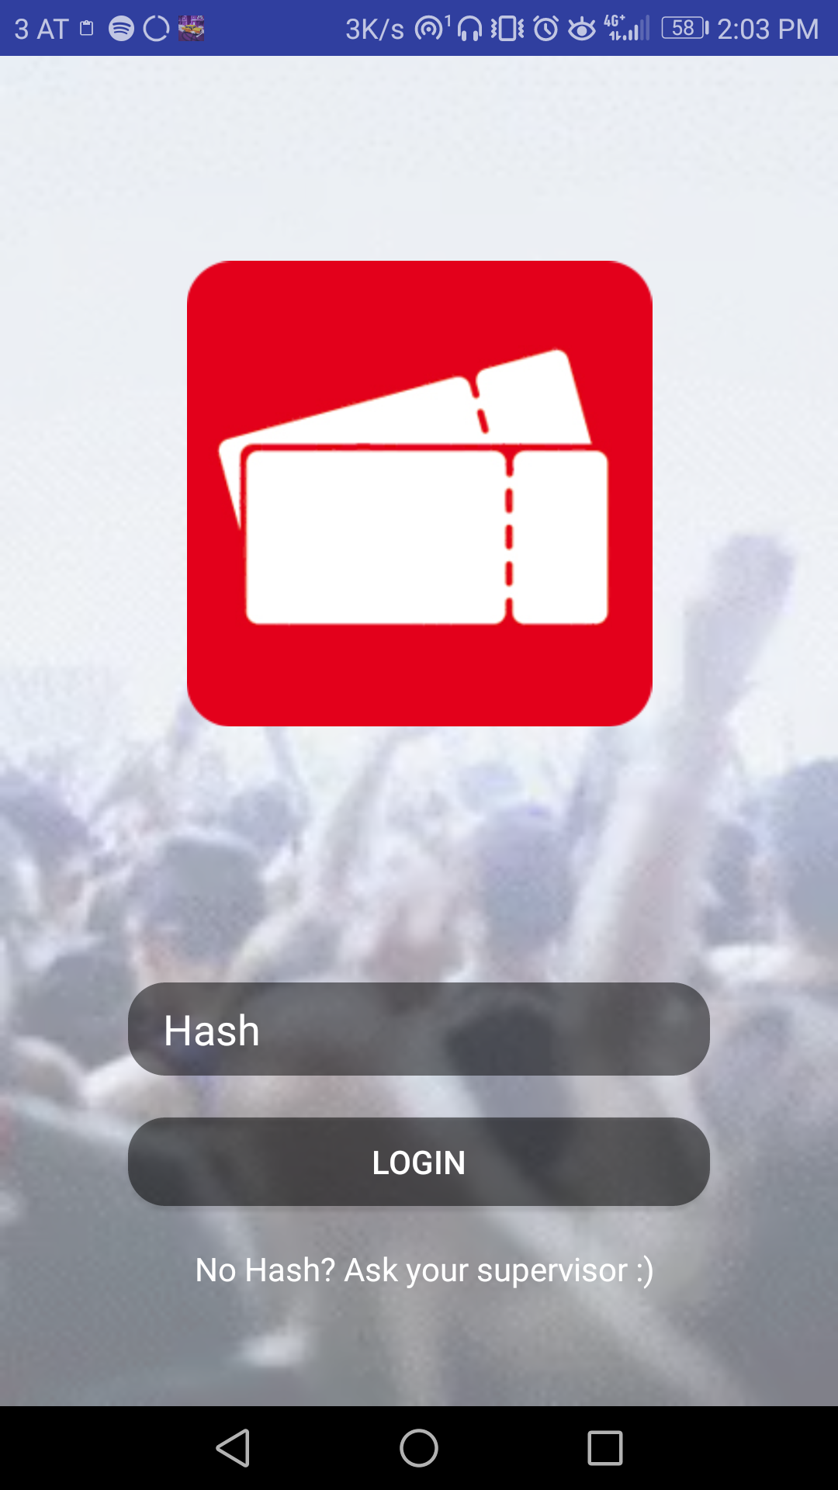
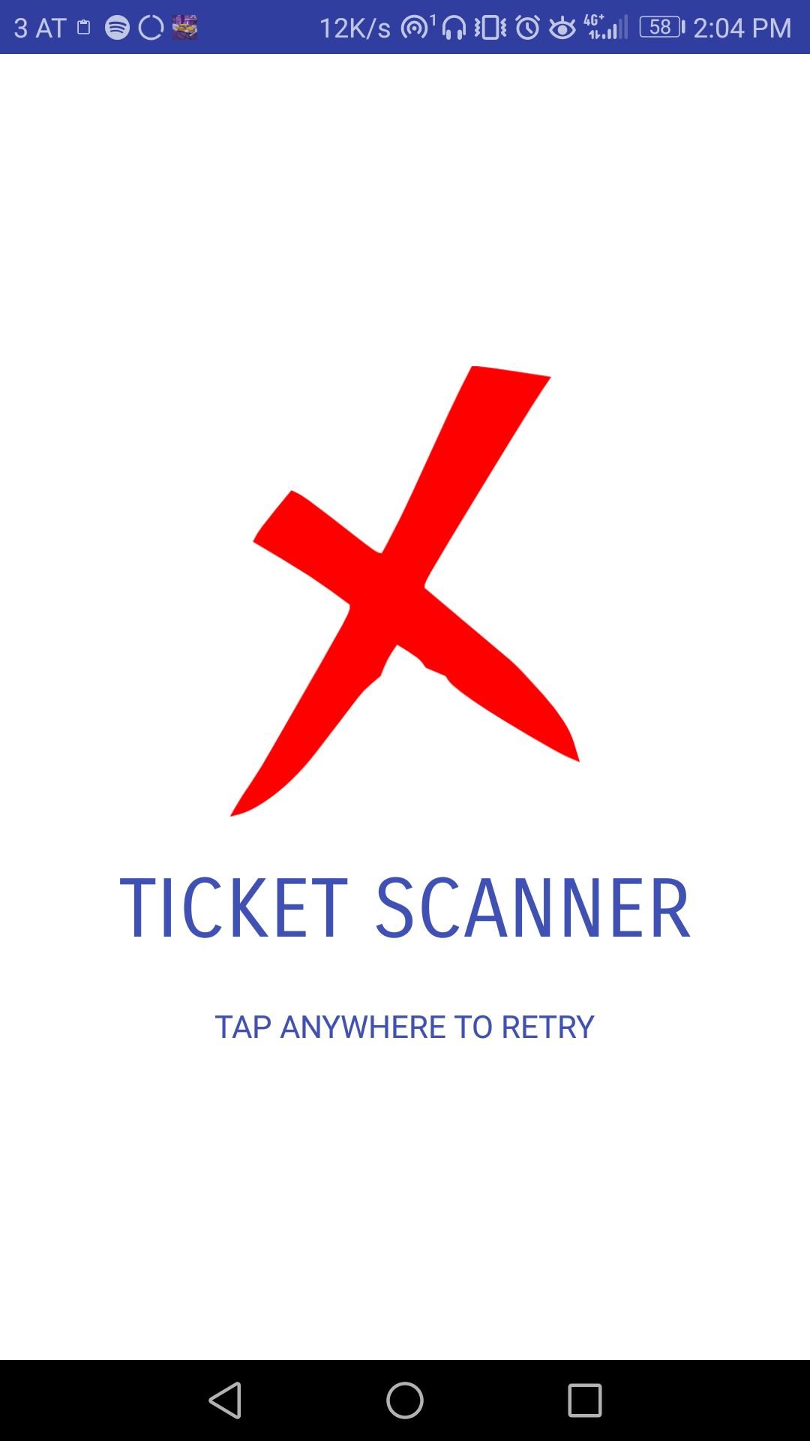
Android Apps
Welcome Screen
Login
QR Starter

Slide 13
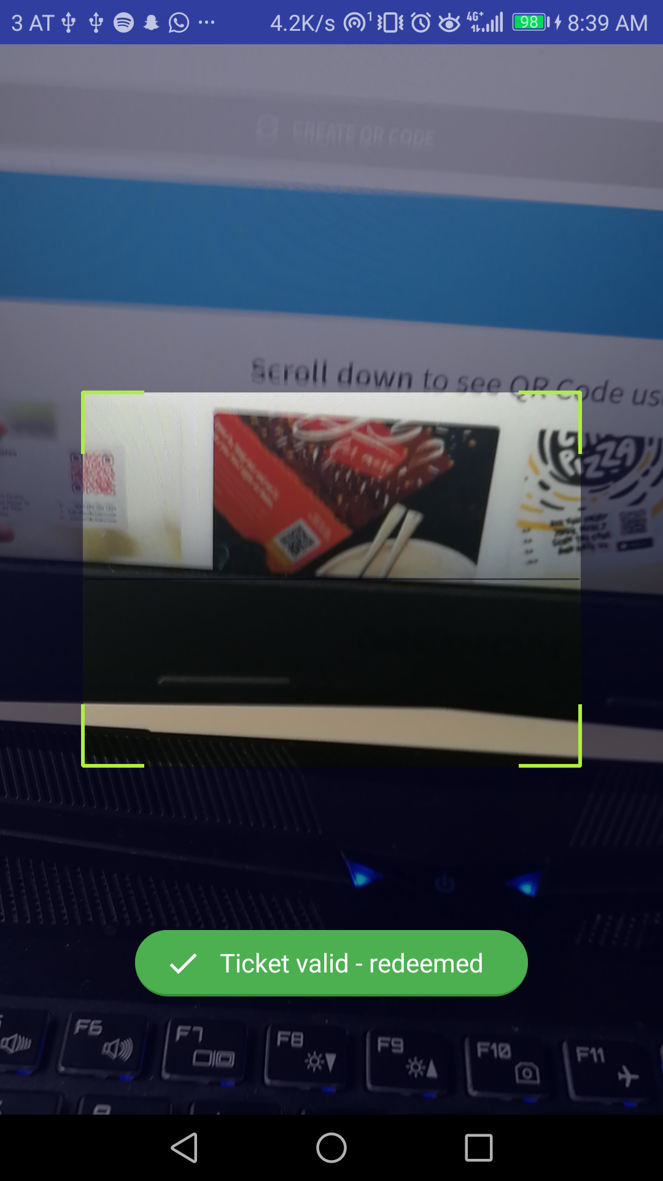
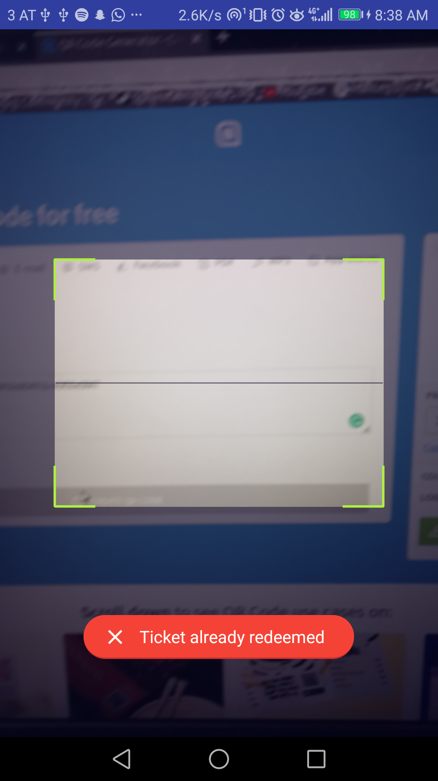
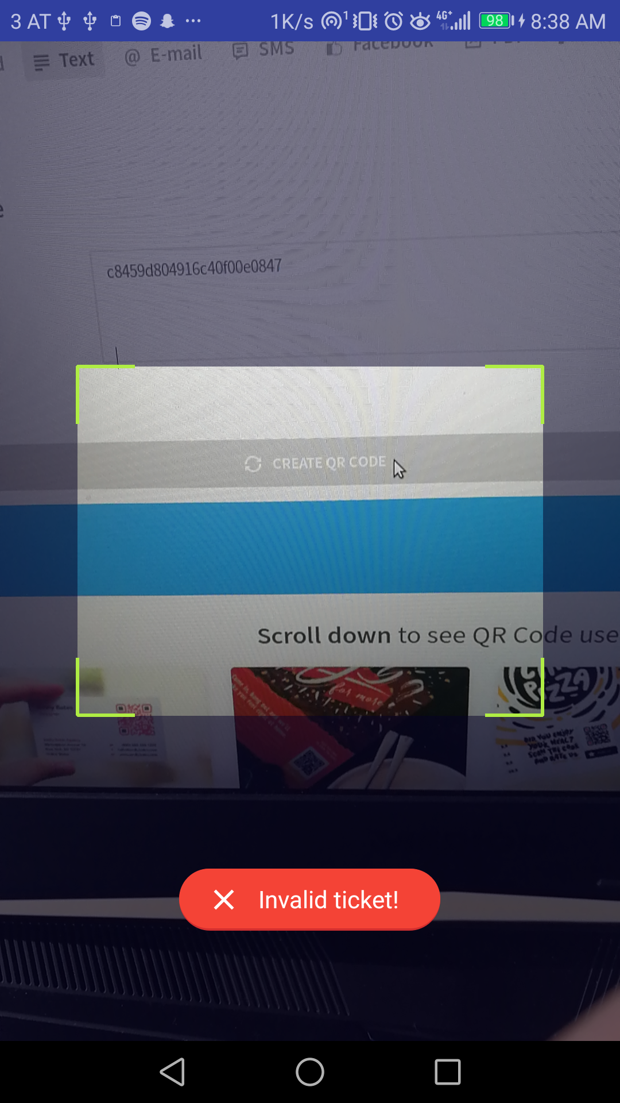
Android Apps
Redeemed
Already Redeemed
Invalid Ticket

Slide 14
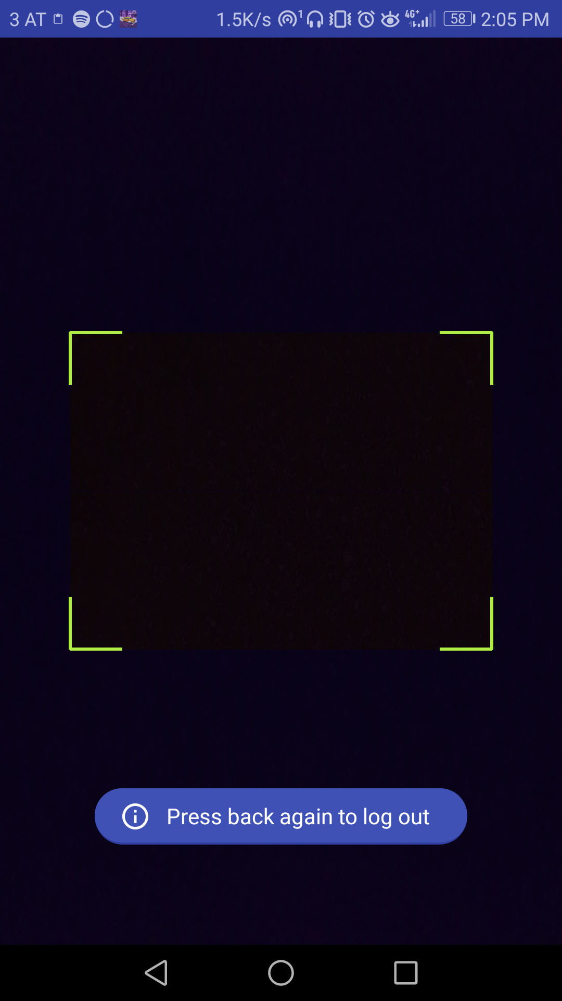
Android Apps
Overwritten back buttons

Slide 15
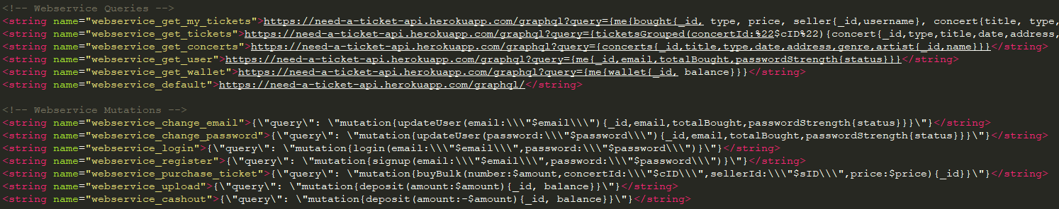
Android Apps
GraphQL Access

Slide 16
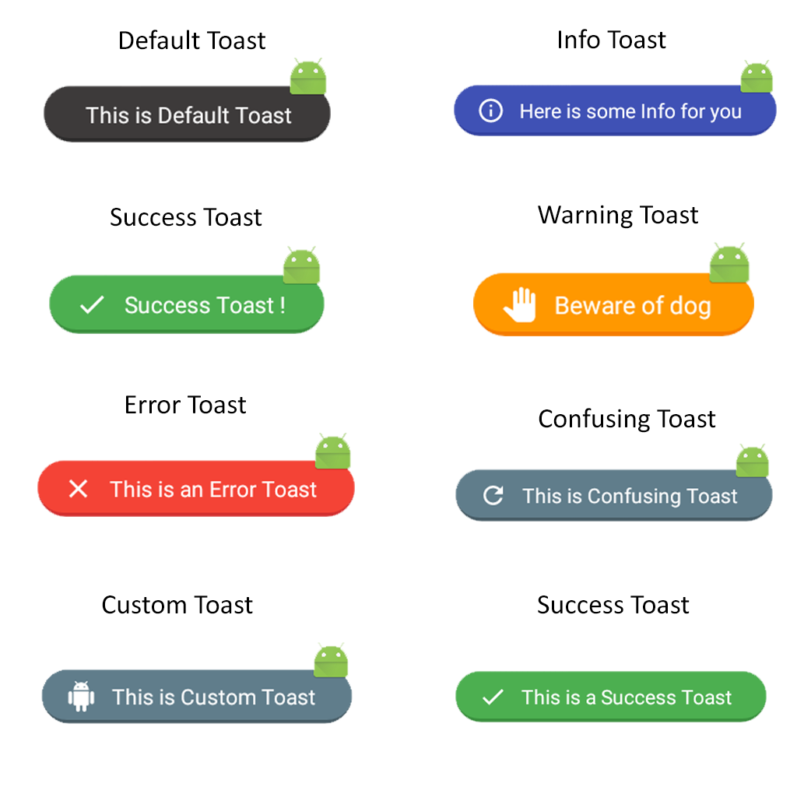
Android Apps
Fancy Toast

Slide 17
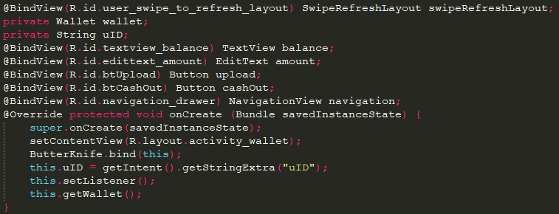
Android Apps
Butter Knife

Slide 18
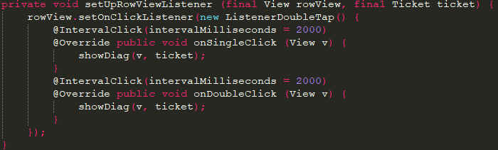
Android Apps
Android Annotations Interval Click

Slide 19


Android Apps
Continuous Inspection
Code Quality:
Bugs
Vulnerabilities
Technical Debt
Unclean Code
Application Security:
CWE
OWASP
SANS

Slide 20
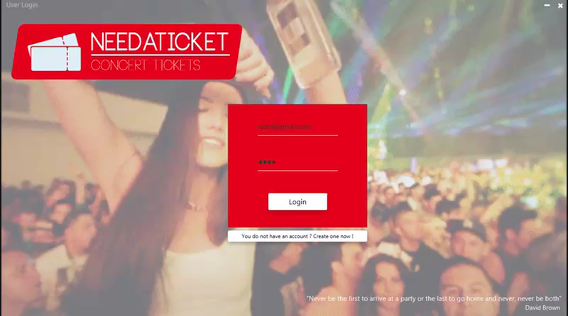
Creator Application

Slide 21
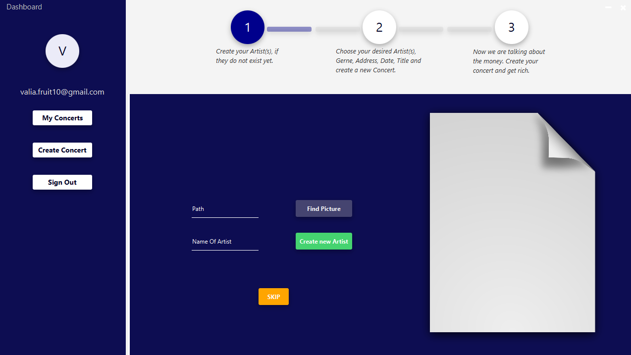
Create Concert – [1]

Slide 22
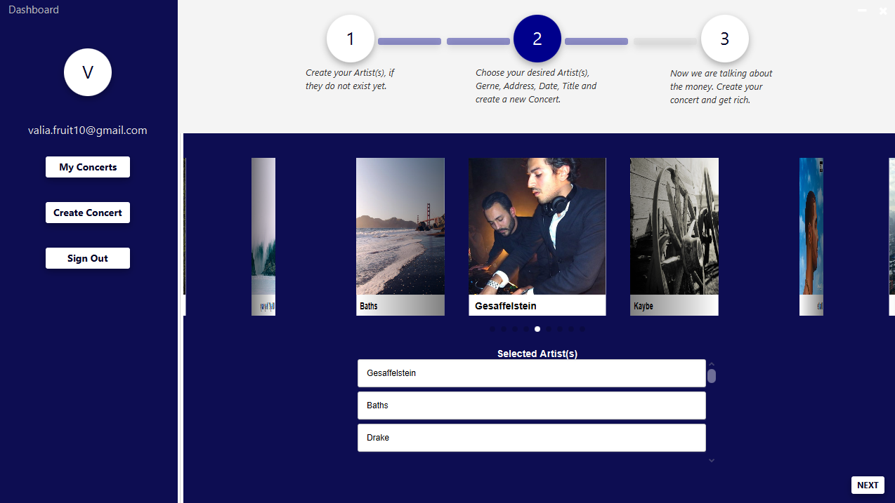
Create Concert – [2]

Slide 23
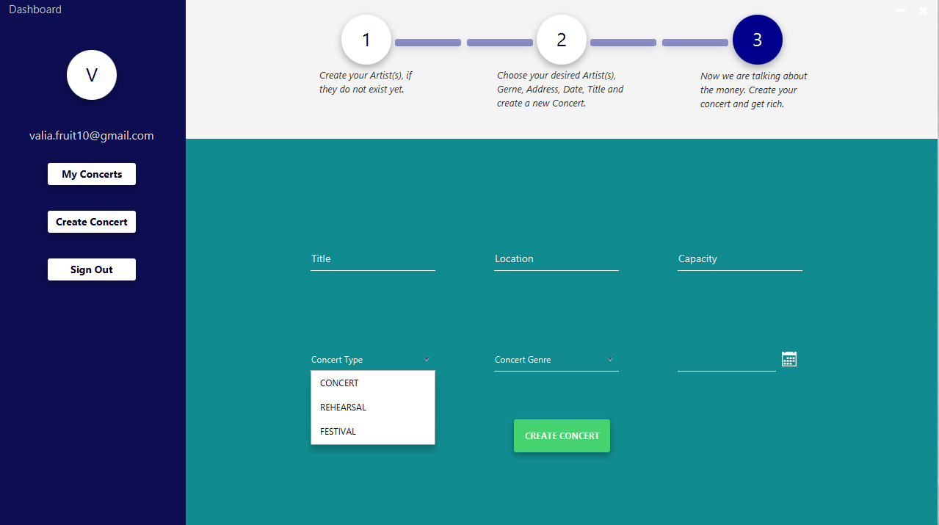
Create Concert – [3]

Slide 24
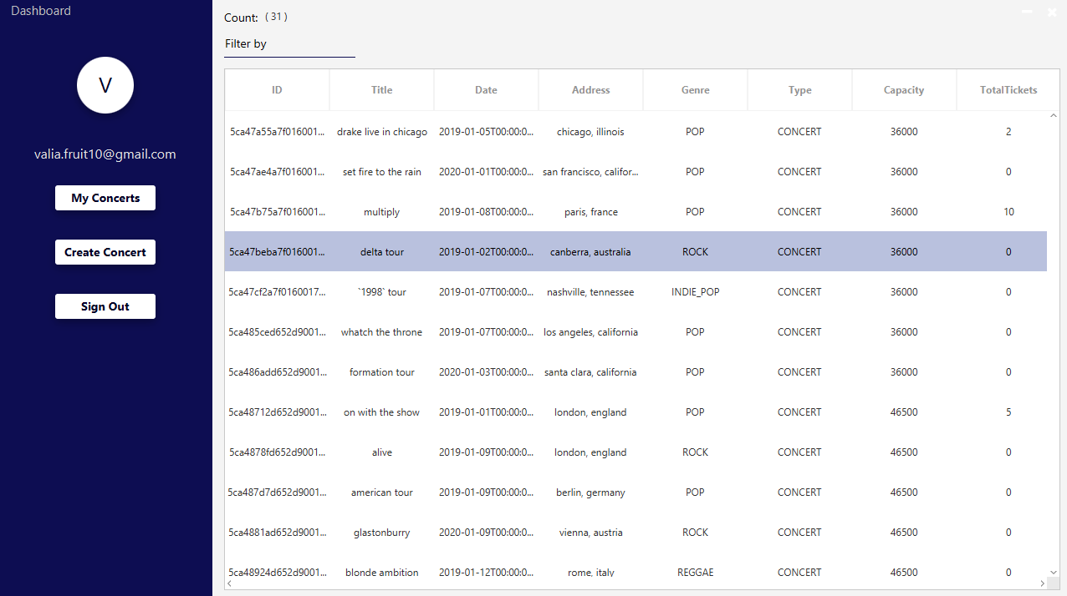
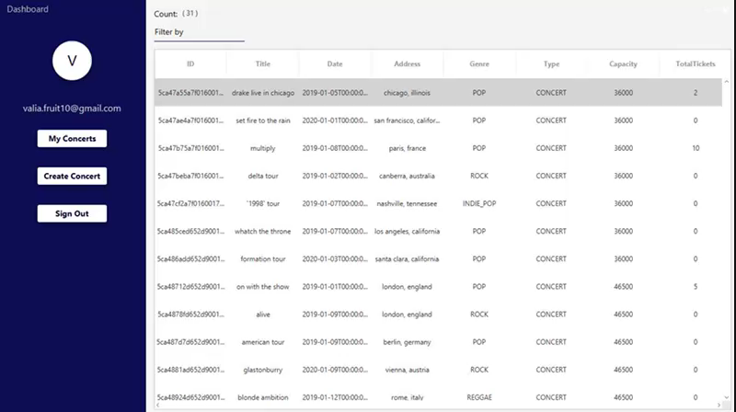
My Concerts (filtering)

Slide 25
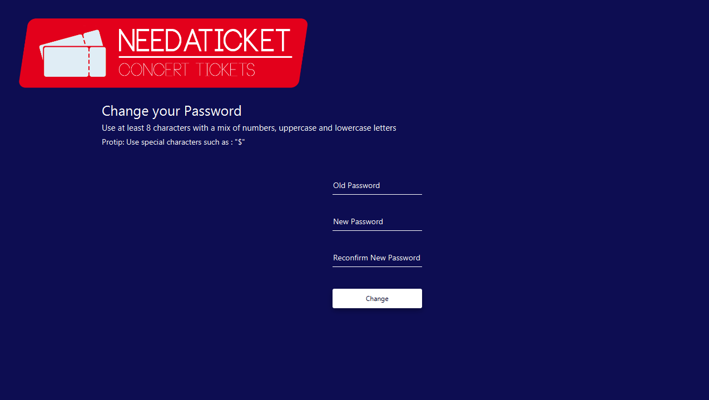
Change Password

Slide 26
Seller Application

Slide 27
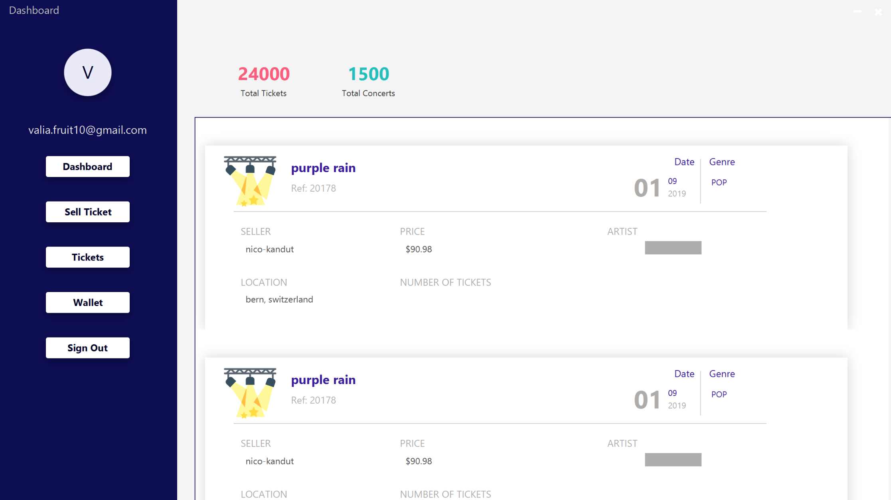
Tickets

Slide 28
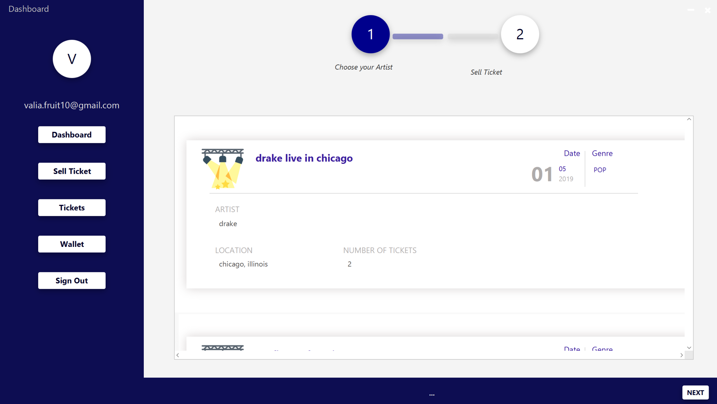
Sell Ticket

Slide 29
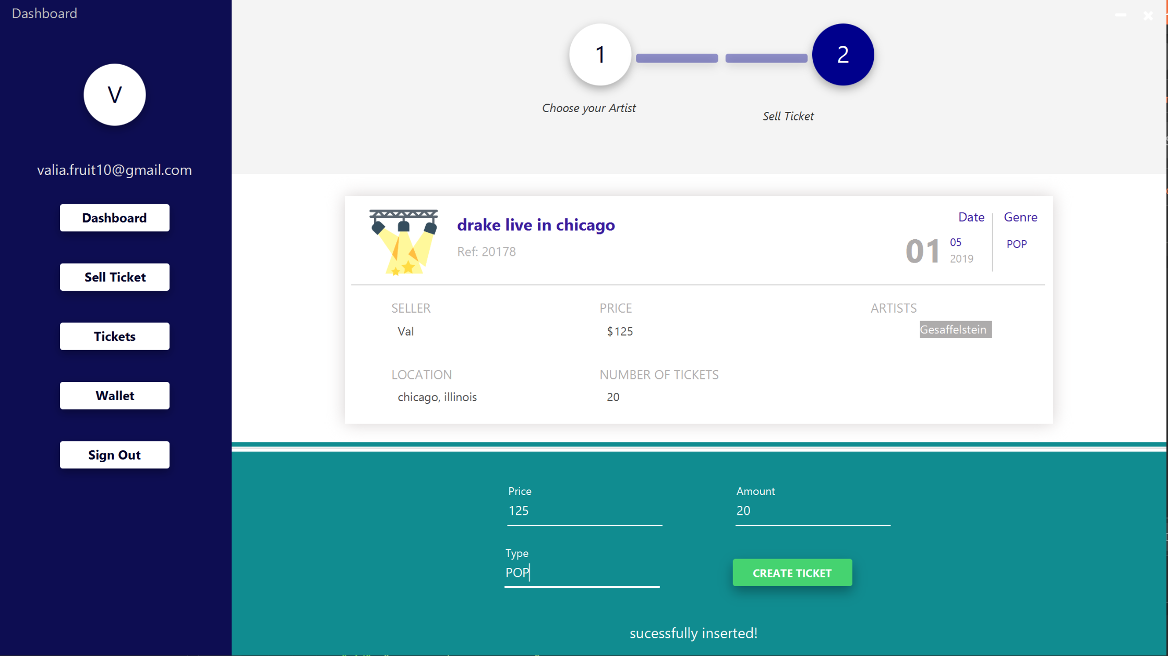

Slide 30
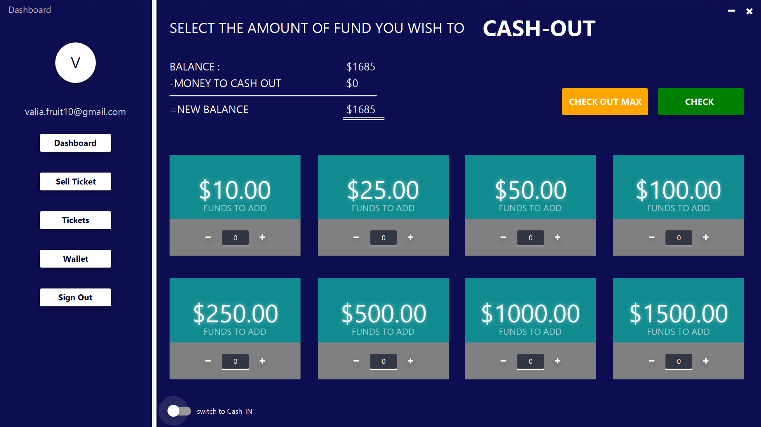
Wallet

Slide 31
Webservice

Slide 32

Graphql
Kennt den Aufbau von gespeicherten Daten
Liefert genau das, was man benötigt

Slide 33
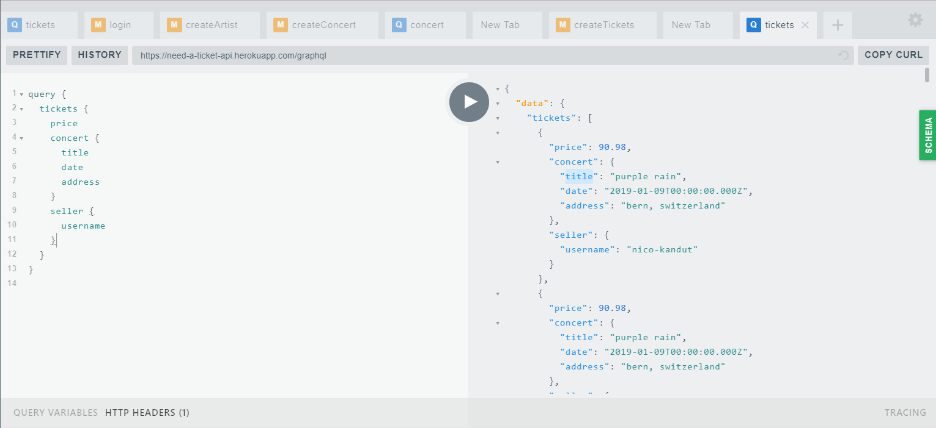

Slide 34
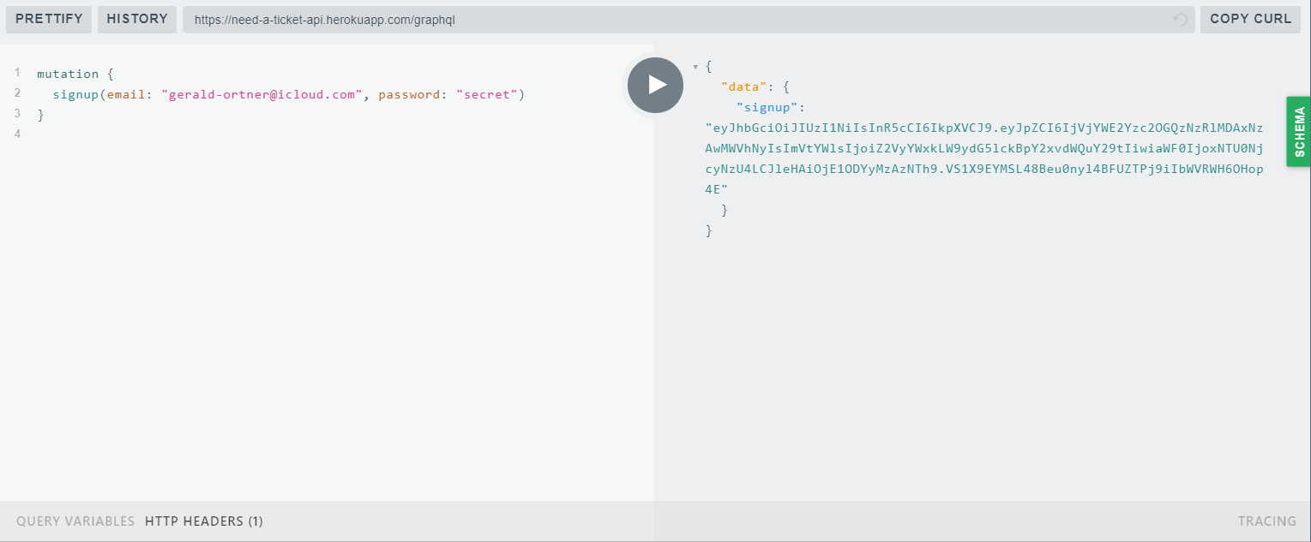

Slide 35
Weiteres
Authorisation mit json web tokens
Mongo datenbank (realtional)
Auf Heroku deployed

Slide 36
NEEDATICKET
CONCERT TICKETS
Vielen Dank für Ihre Aufmerksamkeit!
Notes:
To change the image on this slide, select the picture and delete it. Then click the Pictures icon in the placeholder to insert your own image.

